Slide 1
How to adapt this tool
This page should be deleted when printing (see slide 1 Notes Pane for printing guidance).
This tool was developed to be used by peer outreach workers, peer educators, and other community-based health providers to help provide comprehensive information about pre-exposure prophylaxis (PrEP) to key population peers.
Consider working with Ministry of Health and community stakeholders to adapt this tool as necessary. Ensure that technical information is accurate; circulate a draft for expert review.
Sections highlighted in yellow indicate considerations for adaptation, including words, phrases, and images, that should be reviewed for appropriateness in your local contexts, policies, and guidance. For example, key populations such as men who have sex with men, female sex workers, trans and gender diverse individuals, and people who inject drugs are highlighted on pages 3, 5, 9, 10, 11, 12, 13, and 14, and these terms can be updated to reflect the local context based on consultations with peer outreach workers who will use this tool.
PrEP options that are not approved or available in your country, program, or context should be removed.
Translation of this tool into local languages is recommended.
Programs can consider tailoring this tool for each key population group (e.g., keeping information that is relevant only for men who have sex with men to be used by their peer educators) to reduce page count. In such cases, adjust the alignment of the page numbers with the references in the text as needed.
  Note: Injection drug use can occur among men who have sex with men, female sex workers, and transgender people. People who inject drugs may also have sex and may sell sex as well. Consider keeping the language and perhaps removing the label as appropriate.
Suggested citation: EpiC project. PrEP booklet of frequently asked questions (FAQs): a peer outreach worker tool. Durham (NC): FHI 360; 2024.
Notes:
Additional Guidance and Printing Instructions
Make the national/local information added to the booklet as concise as possible.
Alter the font size and/or change the shapes to accommodate more/less text.
Delete the How to adapt this tool page prior to printing.
Print the remaining pages double-sided on sturdy A4-size paper.
Compile the pages in the proper order.
Bind on the left edge of the page using a binding suitable for the type/weight of the paper.

Slide 2


PrEP Booklet of Frequently Asked Questions (FAQs):
A Peer Outreach Worker Tool

Slide 3


Hey there! Have you heard about PrEP?
WHAT IS PREP?
PrEP is a medication for people who are HIV negative to provide extra protection against HIV.
PrEP is a powerful HIV prevention method you can control on your own.
PrEP can give you confidence that you are protected from HIV.
PrEP does not protect against other sexually transmitted infections (STIs) or unintended pregnancy; condoms are effective methods to protect against STIs and unintended pregnancy.
There are currently three different methods of PrEP — oral PrEP, injectable PrEP, and a vaginal PrEP ring — though not all three may be available where you live or be the best option for you.
Isn’t PrEP just an antiretroviral (ARV) medication for people with HIV?
Why should I take it now?
That’s a great question! PrEP is not a treatment for HIV. PrEP puts a small dose of medicine in your blood; if HIV ever enters your body, PrEP blocks the virus so that it cannot make you ill.
PrEP is taken by people who are HIV negative to prevent getting HIV in the first place. It’s about being proactive and protecting yourself before any exposure happens. Waiting until you are positive means that you will need to take ARVs to manage HIV for life. PrEP is not for life; it is for times in your life when you need an HIV prevention method.
If you think you may have been exposed to HIV within the last 3 days, talk to your provider about considering post-exposure prophylaxis (PEP)! (Refer to page 15 for more information on PEP.)
1

Slide 4
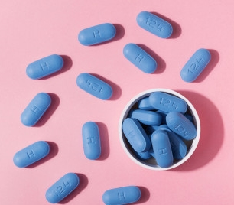
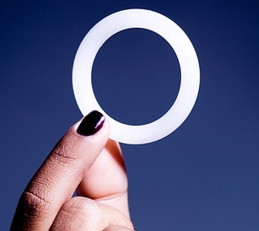
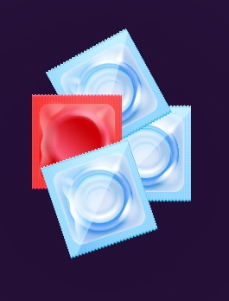
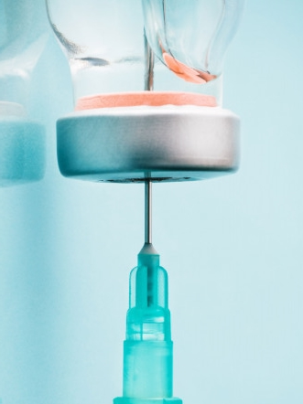
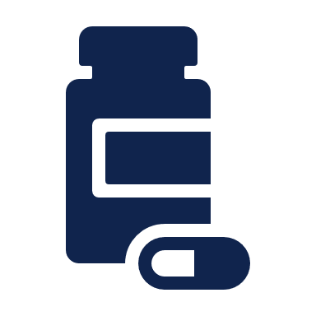

Why should I use PrEP?
PrEP is easy to use, safe, and highly effective when taken correctly!
PrEP allows you to be in control of your health.
Taking PrEP means you are always prepared.
Using PrEP is a proactive choice to keep yourself healthy and HIV free.
PrEP can help you worry less about HIV and more about having strong relationships and chasing your dreams.
[Delete photos of products that are not yet available in your country.]
Get tested every 3 months to confirm you remain HIV negative!
TIP: Ask your provider about using HIV self-test kits to confirm on your own that you are still HIV negative.
How does PrEP differ from PEP?
PrEP is used before exposure to HIV. PEP is a prevention strategy to reduce the risk of HIV after exposure to HIV. (Refer to page 15 for more information.)
2

Slide 5


Comparing PrEP methods: Which is right for me? (1 of 3)
 | Oral PrEP |  | CAB PrEP | PrEP Ring
What is it? | A dosing regimen for most groups of people with sexual or injecting exposure | A dosing regimen for people assigned male at birth with sexual exposure and not taking gender-affirming hormones | An injectable form of PrEP that is given once a month for 2 months, and then once every 2 months thereafter for people with sexual exposure | A flexible silicone ring that is inserted in the vagina and replaced every month for people assigned female at birth with vaginal sexual exposure
Who can use it? | Cisgender women Trans and gender diverse people assigned female at birth (including transgender men) Trans and gender diverse people assigned male at birth (including transgender women) taking gender-affirming hormones People using oral PrEP to prevent HIV acquisition from injecting practices | Cisgender men (including men who have sex with men and men who have sex with women) with sexual exposure to HIV Trans and gender diverse people assigned male at birth (including transgender women) who are not taking gender-affirming hormones and with sexual exposure to HIV | Cisgender men Men who have sex with men Trans and gender diverse people assigned male at birth (including transgender women) (Data is limited for interactions between gender-affirming hormones and CAB PrEP) Cisgender women Trans and gender diverse people assigned female at birth (including transgender men) (data is limited) People who inject drugs (data is limited) | Cisgender women Trans and gender-diverse people assigned female at birth (evidence is not available for people with neovaginas; data is limited for interactions with gender affirming hormones and the PrEP ring)
What is it used for? | For sexual and injection exposure | For sexual exposure only | For sexual exposure only | For vaginal sexual exposure
3

Slide 6
Comparing PrEP methods: Which is right for me? (2 of 3)
 | Oral PrEP |  |  | CAB PrEP | PrEP Ring
 | Dosing regimen for most groups of people with sexual or injecting exposure | Dosing regimen for people assigned male at birth with sexual exposure and not taking gender-affirming hormones | Dosing regimen for people assigned male at birth with sexual exposure and not taking gender-affirming hormones
How often? | 1 pill a day for 7 days before exposure (sexual or injection) and continue taking 1 pill a day for as long as protection is desired (refer to page 9) | 2 pills on the day of sexual exposure (at least 2 hours before, but not >24 hours), and then continue with 1 pill a day for as long as protection is desired (refer to page 10) | Daily; 2 pills on the day of sexual exposure (at least 2 hours before, but not >24 hours), and then continue with 1 pill a day for as long as you desire protection (refer to page 10) | Injection in the buttocks every 8 weeks. The first 2 injections are given 4 weeks apart. | Monthly
How well does it work? | >90% when taken as prescribed |  |  | ~99% | 50% or higher with consistent use
Common side effects (most resolve in a couple of weeks!) | Dizziness, headache, gastrointestinal symptoms (diarrhea, nausea, decreased appetite, abdominal cramping, and flatulence) |  |  | Injection site reactions, fatigue | Vaginal discomfort (itching), urinary tract infections, discharge, pelvic pain
How do I safely stop using PrEP? | After the last exposure, take 1 pill a day for 7 days, but consult your provider! |  | After the last exposure, take 1 pill a day for 2 days, but consult your provider! | Consult your provider! | Remove the PrEP ring and don’t replace it, but consult your provider!
4

Slide 7
Comparing PrEP methods: Which is right for me? (3 of 3)
 | Oral PrEP |  | CAB PrEP | PrEP Ring
 | Dosing regimen for most groups of people with sexual or injecting exposure | Dosing regimen for people assigned male at birth with sexual exposure and not taking gender-affirming hormones
Can men who have sex with men use it? | Yes | Yes | Yes | No
Can female sex workers use it? | Yes | No | Yes | Yes
Can trans people use it? | Yes | Yes | Yes | Yes
Can people use it with gender-affirming hormones? | Yes | No | Yes | No
Can people who inject drugs use it? | Yes | No | Yes (but with limited evidence) | No
Can pregnant or breastfeeding people use it? | Yes | No | [to be updated by countries based on national guidelines] | [to be updated by countries based on national guidelines]
5
Notes:
NB: Dosing regimen for people assigned male at birth with sexual exposure and not taking gender affirming hormones is only for sexual exposure.
PrEP ring is only for sexual vaginal exposure for people assigned female at birth.

Slide 8

General FAQs about PrEP (1 of 3)
I’m not sure I can remember to take a pill every day.
What if I miss a pill, an
injection, or ring replacement?
I'm concerned about side effects.
It’s important to take oral PrEP consistently for it to be most effective. Taking it with food can help alleviate some of the side effects you may feel. Try taking your pill at the same time every day, such as after you brush your teeth or with your breakfast, so that it becomes a part of your daily routine. If your phone allows you to set a daily alarm, that may be helpful too!
If you think you might have trouble remembering to take a daily pill, other options are available. (Refer to pages 3-5 for more information on the different options.) Other options may be a better fit for you if you prefer not to take a pill every day.
You may miss a dose occasionally, but that only means you’re not as protected as you may want to be. You should use condoms in these cases. For the most protection, its important to use PrEP consistently and on schedule.
For oral PrEP, if you miss a dose, take it as soon as you remember, but don’t double up. If you’ve missed many doses, contact your provider to get tested for HIV again. For CAB PrEP or the PrEP ring, if you miss an appointment, don’t worry. Just contact your provider as soon as possible to reschedule your appointment. They can guide you on your next step!
Some people experience mild side effects such as nausea and headaches when they first start taking oral PrEP. Taking food with oral PrEP can help, but it can be taken without food. Those on the PrEP ring may experience changes in vaginal discharge and discomfort. CAB PrEP may cause some injection site reactions. But these side effects usually go away after a few weeks. If they persist, it’s important to talk to me or your provider. We can help you manage any discomfort you might have. (Refer to page 4 for more information.)
6

Slide 9
General FAQs about PrEP (2 of 3)
How do I protect
myself against STIs
while taking PrEP?
I'm taking contraceptives. What options are available for me?
What if I am pregnant or breastfeeding?
PrEP can only protect you against HIV.
You should also continue using condoms while on PrEP to protect yourself against other STI as well as unintended pregnancy. PrEP does not increase your risk of STIs.
All PrEP (oral PrEP, CAB PrEP, and the PrEP ring) options are still available for you if you use any contraceptives! If you ever consider getting pregnant, talk to your provider to explore the best options. Remember, PrEP does not protect against unintended pregnancy.
Oral PrEP and the PrEP ring are considered safe for use during pregnancy and breastfeeding. For CAB PrEP, we are limited in what we know about its use during pregnancy and breastfeeding so talk to your provider for more information about its benefits and potential risks so you can make your own decision about using CAB PrEP during this period. (Refer to pages 3-5 for more information.)
[Update based on national guidelines]
7

Slide 10
General FAQs about PrEP (3 of 3)
I'm taking gender-affirming hormones. What options are available for me?
I use recreational drugs. What options are available for me?
All PrEP options (oral PrEP, CAB PrEP, and the PrEP ring) are available to you! Based on what we know so far, the use of gender-affirming hormones does not reduce the effectiveness of CAB PrEP, and no interactions are expected between gender-affirming hormones and the PrEP ring. However, you should talk to your provider to explore the best option for you!
Oral PrEP, CAB PrEP, and the PrEP ring can all be taken effectively and safely with alcohol or recreational drugs such as heroin and other opioids, cocaine, or meth. However, alcohol consumption may make you forget to take the pills or miss an appointment. Importantly, only oral PrEP is protective against HIV exposure through injection. If you also inject drugs, refer to page 14 for more information.
8

Slide 11
FAQs about oral PrEP dosing regimen for all people with sexual or injecting exposure
Who can use this oral PrEP dosing regimen?
This is the dosing regimen for all people, including people assigned female at birth, individuals taking gender-affirming hormones, and people who inject drugs with sexual or injecting exposure. Let's look at the diagram to better understand this method.
DAY 1
DAY 2
DAY 3
DAY 4
DAY 5
DAY 6
DAY 7
EXPOSED
Continue PrEP with one dose each day for as long as protection is desired
DAY 7
DAY 6
DAY 5
DAY 4
DAY 3
DAY 2
DAY 1
Oral PrEP dose | Potential exposure covered by PrEP | Continuous PrEP taking, with one dose each day
Time to start PrEP before potential exposure | Time covered by PrEP | Time to stop PrEP after last potential exposure
EXPOSED
Source: World Health Organization. WHO implementation tool for pre-exposure prophylaxis of HIV infection: provider module for oral and long-acting PrEP. Geneva: WHO; 2024. p. 8.
9

Slide 12
FAQs about oral PrEP dosing regimen for people assigned male at birth with sexual exposure and not taking gender-affirming hormones
Who can use this oral PrEP dosing regimen?
PrEP for a single event, e.g., sex on 1 day
Oral PrEP dose
Potential exposure covered by PrEP
Continuous PrEP taking, with one dose each day
Time to start PrEP before potential exposure
Time covered by PrEP
Time to stop PrEP after last potential exposure
This is a dosing regimen option for people assigned male at birth with sexual exposure and who are not taking gender-affirming hormones whether for a single event, a short timeframe, or a long time. Let's look at the diagram to better understand this method.
[Modify/remove depending on local guidelines for oral PrEP dosing regimens.]
Sexual exposure
DAY 1
DAY 2
DAY 3
Sexual exposure
PrEP for multiple events or daily
DAY 1
DAY 2
DAY 3
DAY 4
DAY 1
DAY 2
Sexual exposure
Sexual exposure
Sexual exposure
Sexual exposure
Continue PrEP with
ONE DOSE EACH DAY
for as long as protection is desired
Source: World Health Organization. WHO implementation tool for pre-exposure prophylaxis of HIV infection: provider module for oral and long-acting PrEP. Geneva: WHO; 2024. p. 8.
10

Slide 13
FAQs for men who have sex with men
I’m worried about the commitment of taking a pill every day.
I’ve also heard about something called 2-1-1 or ED-PrEP. What is that?
PrEP for a single event, e.g., sex on 1 day
I understand that concern. Taking oral PrEP every day is just one option. Other options are available for you that might fit your lifestyle better! For example, there are injectable forms of PrEP. The one that is currently in the market is called CAB PrEP, and you need to get the injection in the buttocks every month for the first 2 months, and only every 2 months thereafter. This can be a good option if you find it hard to remember to take a daily pill. (Refer to pages 3-5 if no other PrEP options are available.)
I’m glad you’ve heard of “2-1-1 dosing”! This is an option for an oral PrEP dosing regimen for you. First, you take 2 pills at least 2 to 24 hours before sex. After that, you can continue taking one pill a day for as long as you want protection. If you want to stop taking PrEP, after your last exposure, you can take one pill a day for 2 more days before you stop. Let's look at the diagram to better understand this method.
DAY 1
DAY 2
DAY 3
Sexual exposure
PrEP for multiple events or daily
DAY 1
DAY 2
DAY 3
DAY 4
DAY 1
DAY 2
Sexual exposure
Sexual exposure
Sexual exposure
Sexual exposure
Continue PrEP with
ONE DOSE EACH DAY
for as long as protection is desired
Oral PrEP dose | Potential exposure covered by PrEP | Continuous PrEP taking, with one dose each day
Time to start PrEP before potential exposure | Time covered by PrEP | Time to stop PrEP after last potential exposure
Sexual exposure
Source: World Health Organization. WHO implementation tool for pre-exposure prophylaxis of HIV infection: provider module for oral and long-acting PrEP. Geneva: WHO; 2024. p. 8.
11

Slide 14
FAQs for female sex workers
Tell me more about the
different types of PrEP.
I’ve heard there’s more
than just the daily pill.
The PrEP ring sounds interesting. How effective is it? Will my clients feel it during sex?
That’s reassuring. But what if I forget to replace the rIng?
The PrEP ring is effective when used correctly, keeping it in the vagina the whole month and replacing it every month. It releases a steady dose of medication over the month, providing continuous protection against exposure through vaginal sex. It would not protect you for anal sex. The efficacy is slightly lower than with other methods, but it provides extra protection in case you don’t or can’t use a condom or it breaks. It is also very discreet and cannot be felt during sex. It is a great option if you are concerned about privacy.
Forgetting to replace the PrEP ring occasionally isn’t the end of the world. But it’s important to replace the ring as quickly as possible to make sure it continues to work well. If you forget, just replace it as soon as you remember. If you forget to replace it for a long time, talk to you provider to discuss the best way forward.
Absolutely! There are different PrEP modalities to fit different lifestyles. Besides the oral pill, there is also the PrEP ring, which is a discreet, flexible ring that you insert in your vagina and replace once a month. There is also an injectable option, CAB PrEP. For this, you only need an injection every 2 months! (Refer to pages 3-5.)
12

Slide 15
FAQs for trans and gender diverse individuals
I heard there are different ways to take PrEP. Can you tell me more?
Thanks for that explanation! What other options are there to protect myself while taking gender-affirming hormones?
That’s a great question. You can also use CAB PrEP, which is an injection you can get every 2 months. This option is a good choice if you find it hard to remember to take a pill every day. Again, it’s best to talk to your health care provider to see if this fits your lifestyle and medical needs.
Absolutely! There are many PrEP options available, and you can choose one that fits your priorities and lifestyle best! For oral PrEP, there is a different dosing regimen if you take gender-affirming hormones, so share that with your provider if you do! If you take gender-affirming hormones, let’s look at the diagram on this page. (Refer to page 3-5 for all options; page 9 to discuss oral PrEP regimen for people assigned male at birth not taking gender-affirming hormones.)
DAY 1
DAY 2
DAY 3
DAY 4
DAY 5
DAY 6
DAY 7
EXPOSED
Continue PrEP with one dose each day for as long as protection is desired
DAY 7
DAY 6
DAY 5
DAY 4
DAY 3
DAY 2
DAY 1
Oral PrEP dose | Potential exposure covered by PrEP | Continuous PrEP taking, with one dose each day
Time to start PrEP before potential exposure | Time covered by PrEP | Time to stop PrEP after last potential exposure
EXPOSED
Source: World Health Organization. WHO implementation tool for pre-exposure prophylaxis of HIV infection: provider module for oral and long-acting PrEP. Geneva: WHO; 2024. p. 8.
13

Slide 16
FAQs for people who inject drugs
What options are available for someone like me who injects drugs?
I’ve heard about this alternative oral PrEP dosing called 2-1-1 or ED-PrEP. Can I use that instead of taking a daily pill?
I’m on opioid agonist therapy (OAT) and take methadone or buprenorphine.
Can I also use PrEP for sexual exposures?
Where can I access services like needle and syringe exchanges or OAT?
Oral PrEP is the recommended option for people who inject drugs, which is protective against both sexual and injection exposures. CAB PrEP is also an option for you for sexual exposure and may be effective for injection exposure, but there is less available evidence on injection exposure through clinical trials at this time. Other PrEP options have not been studied yet for people who inject drugs. (Refer to page 9 for the regimen.)
Great question! I’m glad you’ve heard of “2-1-1 dosing.” This is the oral PrEP dosing regimen for people assigned male at birth who are not taking gender-affirming hormones, and it’s protective against sexual exposure, but not for injection exposures. If you use injection drugs, your oral PrEP dosing regimen would be different. (Refer to page 10 for the regimen.)
This is an important question! Yes, you have the option to use either condoms or CAB PrEP for sexual exposure even if you are on OAT. Let your OAT provider know when discussing CAB PrEP. This is very important for your OAT provider to know so they can adjust your dose as needed. You should also let them know of any other medications and therapies you may be taking.
[Add guidance and referral information here for peer to provide based on your program context.]
14

Slide 17

FAQs: Other concerns
Peers may have other concerns about taking PrEP. Below are other concerns that your peers may bring up and how you can respond.
If there is a possible exposure to HIV, refer peers immediately for HIV testing and post-exposure prophylaxis!
PEP must be started within 72 hours (3 days) after potential exposure. The sooner it is started the more effective it is.
PEP must be taken every day for 28 days; after the 28 days, encourage your peer to consider starting PrEP!
PEP is designed for emergency use and isn’t meant for regular use. If you are frequently exposed to HIV or are at high risk, PrEP is a more suitable preventive measure.
If you are experiencing violence or other adverse events…
[Add guidance and referral information here for peers to provide based on your program context.]
              Where can I access HIV testing services and PrEP?
              You can access HIV testing and the PrEP options we discussed today from your provider! You can also initiate/receive refills through several locations in the community as well, including:
              [Add information on decentralized access to PrEP and the various options available in your context.]
              Can I use HIV self-testing (HIVST) with PrEP?
              [Update based on national guidance.]
              Yes! HIVST kits can be used to refill oral PrEP or the PrEP ring. We still cannot use HIVST kits for CAB PrEP due to lack of evidence. You can ask your provider more about HIV self-testing. If you want to use an HIVST kit now, you can access them through:
              [Add information about where peers can access HIVST kits.]
15

Slide 18


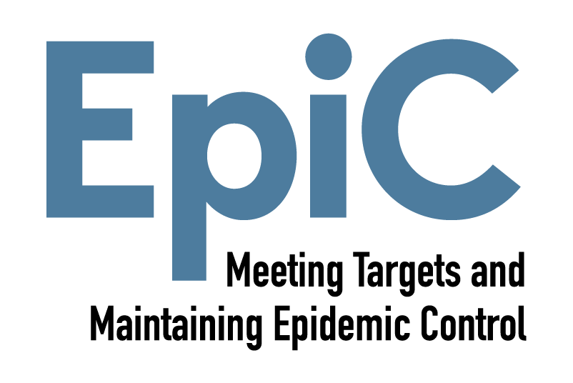
This resource is made possible by the generous support of the American people through PEPFAR and USAID. The contents are the responsibility of the EpiC project and Global Black Gay Men Connect (GBGMC) and do not necessarily reflect the views of PEPFAR, USAID, or the U.S. Government.
EpiC is a global cooperative agreement (7200AA19CA00002) led by FHI 360 with core partners Right to Care, Palladium International, and Population Services International (PSI).

