Slide 1
Working with Different Groups
Module 3 (f)
People who Inject Drugs

Slide 2
People who inject drugs: Assumptions and stereotypes
What do we think of when we hear of:
Drug addicts?
Alcoholics?
People who inject drugs?

Slide 4
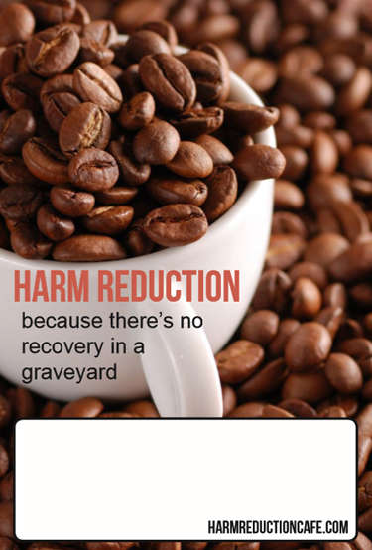
PWID and HIV
Extremely vulnerable to HIV
HIV prevalence among people who inject drugs is 28 times higher than among the rest of the population
Poor access to healthcare: criminalised and stigmatised
Estimated 12 million people who inject drugs worldwide, 1.6 million (one in seven) HIV-positive
Highest prevalence: China, Russia, USA, South-West Asia, and Eastern and South-Eastern Europe*
*one of the few parts of the world where HIV prevalence is increasing – UNAIDS 2016
Avert.org
Harm Reduction International 2016
Notes:
Harm Reduction International (2016) ‘The Case for a Harm Reduction Decade: Progress, potential and paradigm shifts’

Slide 5
AVERT.org
Notes:
https://www.avert.org/professionals/hiv-social-issues/key-affected-populations/people-inject-drugs

Slide 6
PWID in South Africa
There is a need for increased access to sterile injecting equipment, education around safer injecting practices, and access to sexual and reproductive health services for PWID in South Africa.
Programmes for PWID should also address the specific needs of female PWID, PWID who sell sex, and PWID from previously disadvantaged communities
Gap in information on HIV prevalence for this population group
Scheibe A., et al. Int J Drug Policy 2016
Notes:
[Insert country specific information]

Slide 7
PrEP and PWID
Intersection with other key populations – e.g. MSM, sex workers, prisoners
Studies have shown that PrEP reduces HIV in people who inject drugs
Alcohol and substance use are NOT a reason to refuse PrEP
Part of a combination prevention package

Slide 8
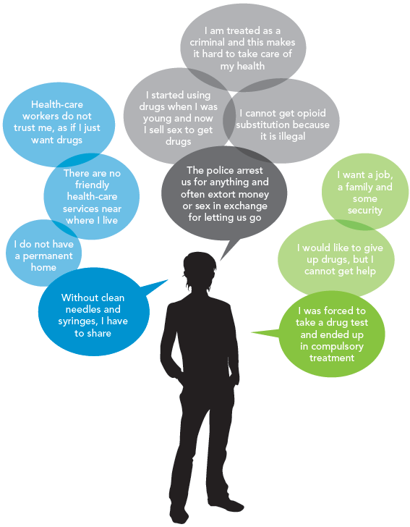
“I am an injecting drug user.
I face these issues.”
UNAIDS GAP Report 2014

Slide 9
Important considerations with PWID
Combination HIV prevention is vital
Must strive to stop discrimination and marginalisation
Encourage participation in programmes and interventions
Access to mental health services, sexual health check-ups, and condoms are necessary
Harm reduction measures are needed:
needle and syringe programmes (NSP)
opioid substitution therapy (OST)
Sensitivity to other co-existing factors

Slide 10
PWID, PrEP, and research: A positive response, with caveats
Study looking at willingness to use PrEP among HIV-negative PWID (n=543)
One third (35.4%) expressed willingness to use PrEP
Younger age, no regular employment, requiring help injecting, engaging in sex work, and reporting multiple recent sexual partners were positively associated with willingness to use PrEP.
Although willingness to use PrEP was low, PrEP was acceptable to some PWID at heightened risk for HIV infection
Escudero DJ, et al. AIDS Behav. 2015

Slide 11
PWID, PrEP, and research
'PrEP is not ready for our community, and our community is not ready for PrEP': pre-exposure prophylaxis for HIV for people who inject drugs and limits to the HIV prevention response. – Study looking at PWID views on PrEP
Reflected the following:
Enthusiasm from PWID for PrEP, but three main concerns:
Feasibility and ethics of PrEP
Potential use as a substitute for other harm reduction strategies
How a focus on PrEP heralds a re-medicalisation of HIV
These concerns are related to the broader context related to poor access to and gaps in effective services; opposition to harm reduction strategies and the funding thereof; and the rights of PWID
Guise A., et al. Addiction 2016
Notes:
People who use drugs have fundamental concerns about the potential impacts of pre-exposure prophylaxis for HIV which reflect a 'fault line' in HIV prevention: a predominance of biomedical approaches over community perspectives. Greater community engagement in HIV prevention strategy is needed, or we risk continuing to ignore the need for action on the underlying structural drivers and social context of the HIV epidemic.

Slide 12
PWID research
Bangkok Tenofovir Study: Antiretroviral prophylaxis for HIV infection in injecting drug users:
A randomised, double-blind, placebo-controlled phase 3 trial
Daily oral tenofovir reduced the risk of HIV infection in people who inject drugs.
Pre-exposure prophylaxis with tenofovir can now be considered for use as part of an HIV prevention package for people who inject drugs.
Attitudes and acceptance of oral and parenteral HIV preexposure prophylaxis among potential user groups
A multinational study
Surveys of willingness to use PrEP products were conducted with 1,790 members of potential user groups (FSWs, MSM, IDUs, SDCs and young women) in seven countries: Peru, Ukraine, India, Kenya, Botswana, Uganda and South Africa.
Results: Key user groups perceived PrEP as giving them new possibilities in their lives and would consider using it when available.
A general willingness to adopt PrEP in key populations, which suggests that if efficacious and affordable, it could be a useful tool in HIV prevention.
The results suggest that delivery in a long lasting injection would be a good target in drug development.
Choopanya, Kachit et al. 2013
Eisingerich AB et al 2012
Notes:
Eisingerich AB et al 2012

Slide 13
PWID, PrEP, and research
Despite positive trial results confirming that PrEP may prevent HIV transmission among PWIDs, there remain many questions regarding the interpretation of these results, as well as obstacles to the implementation of PrEP regimens within highly diverse drug-using communities.
Aside from the Bangkok Tenofovir Study, only one other published study (Eisingerich et al. 2012) has collected empirical data to inform the use of PrEP among PWIDs.
The large gap in research regarding the use and implementation of PrEP for PWIDs signals the need for further research and attention.
Escudero DJ et al. JIAS 2014
Eisingerich et al. PlosOne 2012

Slide 14
References
Andrew Scheibe, Simon Howell, Alexandra Müller, Munyaradzi Katumba, Bram Langen, Lillian Artz, and Monique Marks. Finding solid ground: law enforcement, key populations and their health and rights in South Africa. J Int AIDS Soc. 2016; 19(4Suppl 3): 20872.
The Gap Report. UNAIDS 2014
Escudero DJ, Kerr T, Wood E, Nguyen P, Lurie MN, Sued O, Marshall BD. Acceptability of HIV Pre-exposure Prophylaxis (PREP) Among People Who Inject Drugs (PWID) in a Canadian Setting. AIDS Behav. 2015 May;19(5):752-7
Guise A, Albers ER, Strathdee SA. 'PrEP is not ready for our community, and our community is not ready for PrEP': pre-exposure prophylaxis for HIV for people who inject drugs and limits to the HIV prevention response. Addiction. 2016 Jun 8. [Epub ahead of print]
Escudero DJ, Lurie MN, Kerr T, Howe CJ, Marshal BDL. HIV pre-exposure prophylaxis for people who inject drugs: a review of current results and an agenda for future research. Journal of the International AIDS Society 2014, 17:18899
Eisingerich AB, Wheelock A, Gomez GB, Garnett GP, Dybul MR, Piot PK. Attitudes and acceptance of oral and parenteral HIV preexposure prophylaxis among potential user groups: a multinational study. PLoS One. 2012; 7(1):e28238.
Choopanya, Kachit et al. Antiretroviral prophylaxis for HIV infection in injecting drug users in Bangkok, Thailand (the Bangkok Tenofovir Study): a randomised, double-blind, placebo-controlled phase 3 trial The Lancet , Volume 381 , Issue 9883 , 2083 - 2090 ,15 June 2013

Slide 15
Acknowledgements
With thanks to:
The Southern African HIV Clinicians Society
Wits Reproductive Health and HIV Institute (Melanie Pleaner)

