Slide 1
Working with Different Groups
Module 3(a)
Different groups, different needs

Slide 2
Session overview
Key and vulnerable populations
Sensitisation
Working with different groups (integrated session with modules 3b - 3g)
MSM
Sex workers
Adolescents
Serodiscordant couples
People who inject drugs
Prisoners

Slide 3
Key populations and vulnerable populations
Key Populations
Vulnerable Populations
Defined groups who, due to specific higher-risk behaviours, are most at risk risk of HIV, irrespective of the epidemic type or local context.
Barriers to accessing HIV care and treatment.
Discriminated against.
Recognised internationally.
Groups of people who are particularly vulnerable to HIV infection in certain situations or contexts.
Barriers to accessing HIV care and treatment.
These populations are not affected by HIV uniformly across all countries and epidemics.
WHO 2013
Notes:
People talk about KP and VP = these sometimes get used interchangeable and can lead to confusion. What is the difference between KP and VP?
There is a continuum between the two groups.
The important thing for this training is that KP have been recognised nationally and internationally as specific groups that are epidemiologically shown to be at particular high risk – prevalence and incidence. Vulnerable groups can also be at high risk, but globally they tend not to be as uniformly at as high risk as key populations. The take away, is that key populations are KEY to ending the HIV epidemic.
VG -
Note that they are specific, at increased risk, because of specific vulnerabilities, behaviour, and definition is irrespective of epidemic type, or local context.
The new grouping ‘Vulnerable Groups’ clarifies the previous problems of definitions
Reference: Consolidated guidelines on HIV prevention, diagnosis, treatment and care for key populations.
I.World Health Organization. ISBN 978 92 4 150743 1 (NLM classification: WC 503.6)
http://www.who.int/hiv/pub/guidelines/arv2013/intro/keyterms/en/

Slide 4
Key populations and vulnerable populations
Key Populations | Vulnerable Populations
Men who have sex with men (MSM) Prison populations People who inject drugs (PWID) Sex workers (SW) Adolescent girls and young women (AGYW) | Adolescents and young women (AGYW) Disabled Displaced populations/migrants Orphans and street children
... Each country should define the specific populations that are particularly vulnerable and key to their epidemic and response, based on the epidemiological and social context.

Slide 5
Vulnerable populations in South Africa
Specific groups have HIV prevalence above national average (12.2%). These include:
Black women aged 20–34 years (HIV prevalence 31.6%)
People co-habiting (30.9%)
Black men aged 25–49 years (25.7%)
Disabled persons 15+ years (16.7%)
High-risk alcohol drinkers 15+ years (14.3%)
Recreational drug users (12.7%)
Almost 2000 new HIV infections in young women and adolescent girls (aged 15–24) each week, a rate two and a half times that among males of the same age.
Female sex workers: 40-70% HIV prevalence, depending on site
Shisana, O et al. (2014)
UCSF, Anova Health Institute, WRHI (2015)
Notes:
[Insert country specific information]

Slide 6
Why sensitisation?
The provision of PrEP is particularly useful for key populations and vulnerable people
Many of the groups who will potentially benefit from PrEP face barriers to healthcare, discrimination, and marginalisation. These include:
MSM
Sex workers
Adolescent girls and young women
People who inject drugs
Prisoners
Serodiscordant couples
People who perceive themselves at substantial risk
Notes:
The focus will be determined by country-specific resources, trends in HIV prevalence, priorities and guidelines
e.g. in South Africa in the public sector, PrEP is available for sex workers at selected project sites, but is available in the private sector and at other demonstration projects for other groups. Country specific emphasis can be inserted here.

Slide 7
Key populations: Overlap of sub-groups
Inter-relationships and intersections
Sex workers
Transgender
Men who have sex with men
People who use drugs
Adolescents,
young people
Prisoners

Slide 8
What do we mean by sensitisation?
What does this term mean to you?
Notes:
The focus will be determined by country-specific resources, trends in HIV prevalence, priorities and guidelines
e.g. in South Africa in the public sector, PrEP is available for sex workers at selected project sites, but is available in the private sector and at other demonstration projects for other groups. Country specific emphasis can be inserted here.

Slide 9
What do we mean by sensitisation?
Understanding the needs and concerns of different groups
Understanding the special considerations to be taken into account when rendering services to different groups
Being aware of factors which create barriers to communication and services, and ways we can remove barriers to provide effective care
PrEP is part of a combination prevention package – what other options are there? What other services should we be thinking about to ensure holistic care?
In other words - having the knowledge, attitude, and skills to provide an effective service to different groups
Notes:
The focus will be determined by country-specific resources, trends in HIV prevalence, priorities and guidelines
e.g. in South Africa in the public sector, PrEP is available for sex workers at selected project sites, but is available in the private sector and at other demonstration projects for other groups. Country specific emphasis can be inserted here.

Slide 10
What do we mean by sensitisation?
PrEP involves talking about risk and sex: being aware of our own values, attitudes, prejudices, and moral judgements, including our feelings and attitude about other peoples’ lifestyles, sexual preferences, and behaviours, and how these may impact on our communication – verbal and non-verbal, and the services we render.
Important: Being sensitised paves the way for trust and meaningful engagement
Notes:
The focus will be determined by country-specific resources, trends in HIV prevalence, priorities and guidelines
e.g. in South Africa in the public sector, PrEP is available for sex workers at selected project sites, but is available in the private sector and at other demonstration projects for other groups. Country specific emphasis can be inserted here.

Slide 11
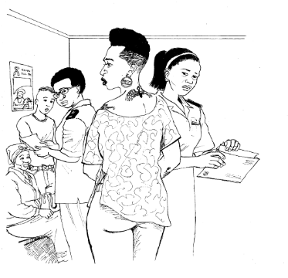
Stigma and stereo types
Give some examples of people, conditions or behaviour which may become stigmatised?
How does stigma/stereotypes affect the way we relate to people? How does it affect the healthcare we provide?

Slide 12
Impact on healthcare
Stigma:
A strong negative feeling, judgment, or disapproval connected to a person because of a characteristic they possess (i.e. an illness, a behaviour, a style of dress)
Discrimination and stereotyping
A person who is stigmatised may internalise the stigma and feel negative about themselves

Slide 13
Impact on healthcare
Attitudes, stereotypes, myths, and prejudice can create barriers to access and use of healthcare
Negative attitudes affect the way health workers engage and communicate with clients
Barriers to using health services weaken the fight against the HIV epidemic and result in poorer health outcomes for the community

Slide 14
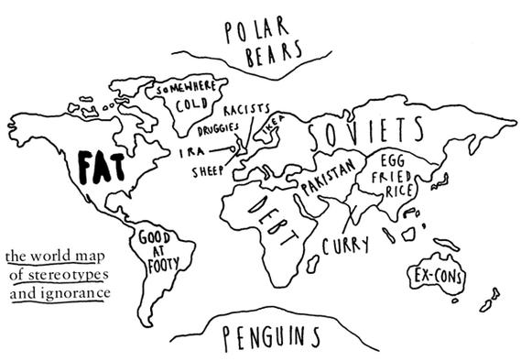
International stereotypes

Slide 15
Multiple barriers impact on key populations
STRUCTURAL
COMMUNITY
PERSONAL
Legal
Religious
Cultural
Rejection/internalized stigma
Not conforming to gender norms
Discrimination
Anxiety
Violence
Stereo typing
Stigma
Ridicule
Stress
Most at risk - HIV, SRH
Family
Extortion
Financial
Unemployment
Poverty
Drug use
Criminilisation
Education
Harassment
Blackmail
Fear
Poverty
Lack of appropriate information
Depression
Lack of access
Healthcare provider attitude
Lack of health skills and knowledge
Health problems
Adapted from: Tucker et al, 2012

Slide 16
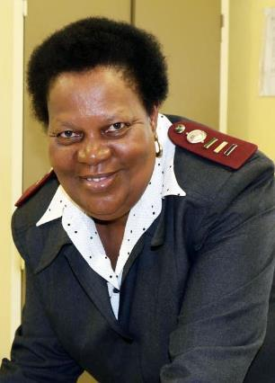
Let’s meet Nurse Thandi
“Hello everybody, my name is Thandi Mbili, I am a registered nurse and I work in a busy community clinic. I have been in my current job for 3 years. I like it here but sometimes I get very frustrated with patients, sometimes they make me angry especially if they won’t listen.
Sometimes I wish I could work in paediatrics so that I would only see children and wouldn’t have to work with adults who do stupid things and then come to the clinic for help. What I dislike most is rude people or people who just complain. I think I need some leave.”
Notes:
[Update to fit your country context]

Slide 17
We visit Nurse Thandi’s clinic!
There are 14 people sitting in the clinic waiting room to see Nurse Thandi.
A deaf 72 year-old woman
A mature man and his young girlfriend
An alcoholic with TB
A pregnant teenager
A policeman with an STI
A Muslim woman with two children
A homeless HIV-positive man
A man with severe depression
A Nigerian businessman
A young man who belongs to a gang
A sex worker
A gay man
A rich housewife, who has been beaten by her husband
A man who is dressed like a woman

Slide 18
Sensitisation: Creating the right environment
Be aware of your personal views, values, attitudes, and how these may create barriers or improve communication
Make all clients feel welcome and respected
Privacy for consultation
(Concern about disclosures of sexuality and status
Monitor your own response AND the colleagues you supervise
Posters addressing diverse sexual health needs of clients
Use client’s name, gender pronouns
(Use their terms, not ours... Ask when not sure!)

Slide 19
Sensitisation: Creating the right environment
Think about how you would ask the following questions:
Sensitive and competent: NOT “so who is the man and who is the woman in the relationship?”
Do not assume:
That partners are heterosexual
That women only have vaginal sex – they may also have anal sex
Familiarise yourself with different sexual practices, for example:
receptive and insertive anal sex
Do you have sex with women, men, or both?
Can I examine your anus to exclude STIs?

Slide 20
Sensitisation: Key points
Important to remember:
Key populations are not a homogenous group
The term “Key population” is a public health label and should be used in the right context
When promoting PrEP to a client it is NOT appropriate to say PrEP is a prevention option for you because you are fall in a key population.
Within groups there are sub-groups, differences, and diversity – don’t stereotype and assume that all people within a group are the same

Slide 21
Core key population services identified by WHO
HIV screening and treatment regardless of CD4 count
Management of HIV-related illness
Appropriate counselling and support
Prevention – PEP and offer PrEP
Prophylaxis
IPT / Fungal / Co-trimoxazole
STI prevention, screening and treatment
Malaria prevention (specific provinces)
Vaccination e.g. hepatitis B, pneumococcal, flu
Integrated TB services – South Africa
Notes:
IPT - Isoniazid preventive therapy

Slide 22
Key Populations: HIV testing services
Need to shift HIV testing promotion from one-off model, to Behaviour Repeated, Routine, Health Maintenance
WHO HIV testing recommendations for Key Populations:
Test regularly according to sexual risk
Effective risk reduction counselling
Linkage to care (both positives and negatives)
Promote couples counselling
Use technology (e.g. Find a clinic or home-based testing)
Have you ever tested for HIV?
When did you last test for HIV? How often do you test? When will you go for your next HIV test?
Siegler, A. et al. AIDS Care 2014

Slide 23
References
Consolidated guidelines on HIV prevention, diagnosis, treatment and care for key populations. World Health Organization. ISBN 978 92 4 150743 1 (NLM classification: WC 503.6). http://www.who.int/hiv/pub/guidelines/arv2013/intro/keyterms/en/
Shisana, O, Rehle, T, Simbayi LC, Zuma, K, Jooste, S, Zungu N, Labadarios, D, Onoya, D et al. (2014) South African National HIV Prevalence, Incidence and Behaviour Survey, 2012. Cape Town, HSRC Press
UCSF, Anova Health Institute & WRHI. South African Health Monitoring Study (SAHMS), Final Report: The Integrated Biological and Behavioural Survey among Female Sex Workers, South Africa 2013-2014. San Francisco: UCSF. 2015.

Slide 24
Overall Acknowledgements
With thanks to:
The Southern African HIV Clinicians Society
Wits Reproductive Health and HIV Institute
The OPTIONS Programme/South Africa
Anova Health Institute

